Slide 1
ELECTROPHORESIS
General Principle
Factors Affecting
Types
Forensic Applications
GENETIC ANALYSER, AUTOCLAVE, LAMINAR AIR FLOW, INCUBATORS

Slide 2
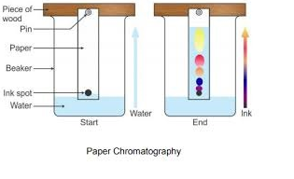
Chromatography
Separation of molecules without the use of current
Compounds need not have charge
Principle- Adsorption*, Affinity*, Capillary Action.
*Adsorption- adhesion of molecules to a surface
*Affinity- Attraction between particles

Slide 3
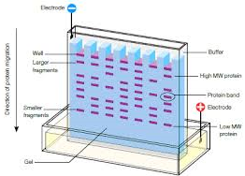
Electrophoresis
Separation of charged particles or molecules in a medium under the influence of an applied Electric Field.
Compounds which has charge can only be separated
Principle- Migration of colloidal particles through a solution under the influence of an electric filed / Electrophoretic Mobility

Slide 4
Continued…….
Commonly known as Electro-kinetic phenomena.
Discovered by Reuss in 1809
Appropriate only to Ionic or Ionogenic material.
Many important biological molecules such as amino acids, peptides, proteins, etc. possess ionizable groups, and therefore, at any given pH, exists in solution as electrically charged species either as cations or anions

Slide 5
Continued….
Under the charge of an electric field, these charged particles will migrate either to cathode or to anode, depending on the nature of their net charge.
Electric field is given by = Voltage
Distance

Slide 6
Electrical Force(F_{e}) is given as the product of Electric Field and Charge.
F_{e} = Є x q
Opposing force or Drag force exerted by the medium is given as the product of friction coefficient(f) and velocity of the particle.
F_{d}= f x v
*f= 6π x r x η ; r =radius of the particle
η= viscous coefficient

Slide 7
These two forces act in opposite directions and ultimately at some point of time, will balance each other, leading to the uniform motion of the particle in the medium.
Therefore,
F_{e} = F_{d}
Є x q= 6π x r x η x v or
Є x q = f x v

Slide 8
Є x q = f x v
Rearranging the terms,
v= q
Є f
v = Electrophoretic Mobility (μ)
Є (Different components in a mixture will hsve different μ, and hence they can be separated.)
Therefore, μ= q or μ = q______
f 6π x r x η x v

Slide 9
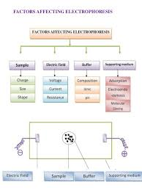
Factors affecting Electrophoresis/ Electrophoretic Mobility

Slide 10
1. Sample
Size – smaller the size, faster the Mobility
Shape- depends upon surface area; lesser surface area, faster Mobility
Charge- μ= q
f
Therefore, more the charge, faster the Mobility.

Slide 11
2. Electric Field
Voltage(V) – Electrophoretic mobility increases with increase in Voltage
Current(I)- Current is directly proportional to electrophoretic mobility, given that resistance remains constant.
Resistance(R)- Resistance is indirectly proportional to Electrophoretic mobility.
In the beginning, Resistance will increase the drag, but after sometime, when the heat starts to dissipate itself, it leads to decrease in Resistance.

Slide 12
3. Supporting Media
Inert medium is always preferred.
Adsorption- Adsorbance increases, μ decreases; causes tailing of the sample, instead of forming a band
Molecular Seiving- Seiving affected by type of gel used.
Electroendoosmosis- Electroendoosmosis is indirectly proportional to μ.

Slide 13
4. BUFFER
Ionic Composition- More the Ionic Composition, faster particle movement.
pH- Ionization increases with increase in pH of an organic compound.
Excess H⁺ | Optimal H⁺ | Less H⁺
O⁻ H⁺ H⁺ | O⁻ H⁺ | O⁻ H⁺
O⁻ H⁺ | O⁻ H⁺ | O⁻ H⁺
O⁻ H⁺ H⁺ | O⁻ H⁺ | O⁻ H⁺
O⁻ H⁺ | O⁻ H⁺ | O⁻ - used for electrophoresis
O⁻ H⁺ H⁺ | O⁻ H⁺ | O⁻ - used for electrophoresis

Slide 14
5. OTHER/ MISCELLANEOUS
Buffer- Buffer affects migration rate of compound and stabilizes the pH of the supporting media.
Heat Generation- Generation of heat from resistive dissipation of energy in electrophoretic medium.
- Can result in Protein degeneration
- Inhibition of enzyme activity
- Gel can start melting
- Increase in diffusion and evaporation
- Convection Current( mixing up of liquid and sample that had to be separated)

Slide 15
ELECTROPHORESIS APPARATUS
Buffer tank- to hold the buffer
Buffer
Electrodes- made up of platinum or carbon
Power Supply
Support Media
Choice of buffer depends on the nature of substance to be separated and the electricity is supplied at a constant current and voltage.

Slide 16
GEL
Commonly used Supporting Medium.
Supporting medium is a physical support through which the charged molecules get separated.
Generally, two types of Gels are used nowadays-
- Agarose Gel
- Polyacrylamide Gel( PAA)

Slide 17
Characteristics of Ideal Gel
Gel matrix should be porous in nature
It should not react with the Sample or Buffer (chemically).
It should not bind physically.

Slide 18
TYPES OF ELECTROPHORESIS
Horizontal & Vertical
SDS PAGE
AGE
Crossed Over Electrophoresis
Capillary Electrophoresis

Slide 19
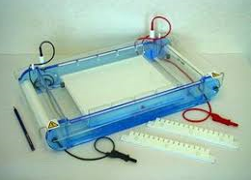
HORIZONTAL & VERTICAL
Horizontal Electrophoresis-
Orientation- Gel is horizontally placed
Type of Gel used- Agarose
Buffer system used- Discontinuous Buffer System
Type of Sample used for separation- 100-500nm long
eg- DNA, RNA
Eg of Horizontal Electrophoresis- Horizontal Agarose Gel Instrument

Slide 20
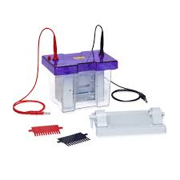
Vertical Electrophoresis
Orientation- Gel is vertically placed
Type of gel used- Polyacrlyamide Gel
Buffer System used- Continuous Buffer System
Type of Sample used for separation- 20-200nm
Amino acids, Polypeptides, Linear proteins, which requires smaller pore size.
Eg of Vertical Electrophoresis- SDS-PAGE

Slide 21
SDS -PAGE
Sodium Dodecyl Sulphate- Polyacrylamide Gel Electrophoresis.
Most widely used method for analysing protein mixture qualitatively(biochemistry, forensics, genetics, molecular biology)
Useful for monitoring protein purification- as separation of protein is based on the size of the particle.
Can also be used for determining the relative molecular mass of a protein.

Slide 22
Continued….
SDS is an anionic detergent. SDS is also called lauryl sulfate.
The sample is first boiled for 5 minutes in buffer containing Beta-Mercaptoethanol and then SDS is added.
Mercaptoethanol will break the disulphide bond present in the sample and denatures the protein
SDS strongly binds to the protein and makes it negatively charged protein completely

Slide 23
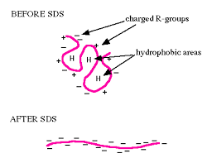
Each protein is fully denatured and open into rod shape with series of negatively charged SDS molecule on polypeptide chain.
Hence, original native charge is completely swamped by the negative charge of the SDS molecule.

Slide 24
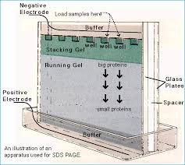
Components of SDS- PAGE
Glass Plates
Comb
Clamp
Sample Buffer
SDS
Glycerol
Mercaptoethanol
Electrodes
Staining Dye

Slide 25
Continued…..
Stacking Gel: Ordering/ Arranging and concentrating the macromolecule before entering the field of separation(4% of acrylamide)
Purpose- to concentrate protein sample in sharp band before it enters the main separating gel.
Running Gel: The actual zone of separation of the particle/ molecules based on their mobility(15% of acrylamide)

Slide 26
Pore Size: routinely used as 3% to 30% which is of pore size 0.2nm to 0.5nm respectively.

Slide 27
Principle:
Separates protein in an electric field
Migrates through a liquid or semisolid medium when subjected to an electric field from cathode to anode terminal.
Molecules flow at different rates depending upon the molecular size of the proteins.

Slide 28
SDS coated large protein molecules migrate slowly through the gel matrix and small proteins migrate quickly through the matrix.
The nearer the band to the well, the larger the molecular size of the protein.

Slide 29
PAGE?
SDS- PAGE is differentiated into two systems-
Continous SDS-PAGE
Discontinuos SDS- PAGE
Polyacrylamide is used to form a gel, a matrix of pores which allow the molecules to migrate at different rates
The size of the pore is determined by the concentration of acrylamide.

Slide 30
The higher the concentration, the smaller the size of the pores.
Discontinuos SDS-PAGE consists of two different gels-
Stacking Gel ( Top gel)
Separating Gel ( Bottom gel)
In Separating gel, protein separate owing to molecular seiving properties.
Smaller particles pass more easily, larger ones retarded by friction.

Slide 31
WHY POLYACRYLAMIDE IS USED AS GEL?
Chemically Inert
Electrically neutral
Hydrophillic
Transparent for optical detection

Slide 32
Preparation of Gel
Clean the plates and combs
Set-up the plates on the rack
Pour the separating gel
Pour the stacking gel

Slide 33
How it is Performed?
Boil the samples for 10 minutes to completely denature the protein.
Assemble the gel into the apparatus
Pour the buffer solution into the chamber
Load 20uL of sample into the well
Run electrophoresis by connecting the current supplies.

Slide 34
Visualization of protein bands can be done under UV-light.
Coomassie Blue and Silver Stain- stains that are commonly used.
Coomassie Blue is least sensitive and can detect only upto 100ng of protein.
Silver Stain is the most sensitive and can detect upto 0.1-1.0 ng of protein

Slide 35
APPLICATIONS
To determine purity of protein samples
Protein identification
To determine molecular weight of protein
To identify disulfide bonds between protein
Molecular weight is determined by comparing the result with a standard curve of relative motility of standard proteins.

Slide 36
ADVANTAGES AND DISADVANTAGES
ADVANTAGES
DISADVANTAGES
Migration is proportional to the molecular weight
Highly Sensitive Test
Requires small amount of sample
Acrylamide Gel is potent neurotoxin chemical
Gel preparation is difficult and requires longer time
Expensive

Slide 37
AGE
Agarose Gel Electrophoresis is a method to separate DNA or RNA molecules by size
Working method is same as that of SDS- PAGE; negatively charged nucleic acid molecules move through an agarose matrix within electric field.
Shorter molecules migrate faster than longer ones through the pores of the gel; process is called seiving.

Slide 38
The gel might be used to look at the DNA in order to quantify it or to isolate a particular band.
The DNA can be visualized in the gel by the addition of Ethidium bromide.
Agarose is a polysaccharide( carbohydrate containing number of sugar molecules bonded together) obtained from the red algae Porphyra umbilicalis.

Slide 39
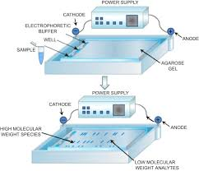
Continued…
Agarose makes an inert matrix.
Most agarose gels are made between 0.7% and 2% agarose.
0.7% used to separate large fragments
2% used to separate smaller fragments

Slide 40
COMPONENTS OF APPARATUS
Gel casting trays- available in variety of sizes and composed of UV transparent plastic.
Sample combs, around which molten agarose is poured to form sample wells in the gel.
Electrophoresis Buffer

Slide 41
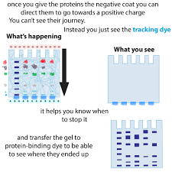
Loading Buffer- which contains something dense(eg. Glycerol) to allow the sample to fall into the sample well
Tracking Dyes- migrates in the gel and allows visual monitoring of the entire process.

Slide 42
How AGE is Performed?
1. CASTING OF GEL
Gel prepared by dissolving agarose powder in a buffer, such as TAE or TBE.
Agarose+ Buffer heated till near boiling point; avoid boiling
Agarose allowed to cool sufficiently, before pouring to casting tray.

Slide 43
Continued…
Cast may warp or crack if Agarose solution is too hot.
Comb placed in the cast to create wells(loading of sample); gel should be completely set.
Concentration of gel affects the resolution of DNA separation. Increase in Concentration of Gel, decrease in pore size and vice- versa.

Slide 44
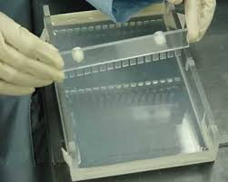
2. LOADING OF SAMPLE
Gel set- Comb is removed- creates wells where DNA samples can be loaded.
Loading Buffer mixed with the sample before the sample is loaded into the well
Loading Buffer can be Glycerol, Sucrose, Ficoll- increases the density of the sample- so as to sink sample into the bottom of the well.

Slide 45
Continued….
Loading Buffer can include colored dyes, such as Xylene, Cyanol, and Bromophenol blue- to monitor progress of electrophoresis.
Samples loaded into well using a micropipette.

Slide 46
3. ELECTROPHORESIS
Most commonly done horizontally, in a submarine mode, where the slab gel is completely submerged in buffer during electrophoresis.
Voltage can be applied. Should not be applied for prolonged period of time, as gel can start melting.

Slide 47
Continued….
High Voltage- reduces resolution, causes band streaking( large DNA fragments)
Low Voltage- broadening of band, due to dispersion and diffusion( for smaller fragments)
DNA marker also run together to determine the molecular weight of the sample( DNA fragments).

Slide 48
4. VISUALIZATION
DNA & RNA- visualized by staining with Ethidium Bromide.
Stain goes and places itself in the major grooves of the nucleic acids and fluoresces under UV light.
Ethidium Bromide can be added to Agarose solution before it gels , or it can be added after electrophoresis is completed.

Slide 49
APPLICATIONS
AGE used in biochemistry, molecular biology, clinical chemistry- separates mixed population of DNA or proteins in a matrix of agarose.
Proteins separated based upon their charges/ size; DNA and RNA fragments by length.
Analysis of PCR products.
Estimation of size of DNA molecules.

Slide 50
CROSSED OVER ELECTROPHORESIS
Also called as crossed immunoelectrophoresis or 2D immunoelectrophoresis.
Technique for quantitation of mixture of proteins and the analysis of the composition of protein mixtures
The method consists of two electrophoretic steps-
Antigen Separation using AGE
Antibody containing Agarose Gel is used for immune-precipitation

Slide 51
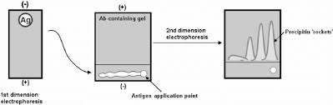
STEP 1
AGE is performed- Casting of Gel, Loading of Sample, Electrophoresis, Visualization
Antigen sample is electrophoresed , which separates the component antigens on the basis of charge.

Slide 52
STEP 2
Agarose Gel Plate containing the antibody is prepared for electro-immunophoresis.
Two parallel cuts are made in the gel, paralle to cathodal edge of the plate.
The gel between the two cuts is removed and a ditch is formed.

Slide 53
Continued….
After the proteins of sample( antigens) have been separated , a strip of the gel containing electrophoretic protein fraction is cut and transferred to the ditch of antibody gel.
Blocks, rulers and knife can be used to cut the antigen containing gel strip properly.
The gel is transferred to the edge of microscopic slide from the knife.

Slide 54
Continued….
With the help of microscopic slide, this strip is placed in ditch in proper position.
Final electrophoresis is run with electric field perpendicular to the strip.
Electrophoresis is continued until all the antigen has been precipitated. It is then dried and visualized using stain

Slide 55
APPLICATIONS
Antigen quantization
Studying immunochemical relationship between antigen and antibody.
Other biochemical and hereditary approaches.

Slide 56
CAPILLARY ELECTROPHORESIS
Slab Electrophoresis- slow, labor intensive, difficult to automate, does not yield definitive quantitative results.
Capillary Electrophoresis- Instrumental version
Substitute for Slab ELectrophoresis
High speed Performance
High resolution separation
Small sample size required- 0.1-10nL
Quantitative detectors can be used instead of staining

Slide 57
Migration Rate in CE
Migration rate of an Ion molecule ‘v’ depends upon the electric field strength.
Electric field is in turn proportional to magnitude of applied Voltage ‘V’ and inversely proportional to Length ‘L’ over which it is applied.
Therefore, Migration rate is product of electrophoretic mobility and applied voltage divided by length over which it is applied.

Slide 58
INFERENCE from Migration Rate
High applied voltage- rapid migration and faster separation.
High resolution
Factors determining High Resolution-
Plate Height
Electro-osmotic Flow( Electro endo-osmosis)

Slide 59
PLATE HEIGHT
Single phase used- only Longitudinal diffusion

Slide 60
ELECTRO- OSMOTIC FLOW(EOF)
EOF produced as a result of dominant surface charges
( commonly negatively charged)
This causes positively charged cations in the double layer close to the channel walls
Under electric potential along the channel, the excess charges in the double layer are attracted by electrostatic forces and thus move towards negative electrode

Slide 61
Continued……
More of cation- faster migration
Equal amount of cations and anions- no migration
More of anions- slower migration

Slide 62
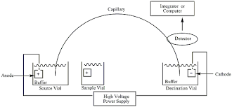
INSTRUMENTATION
Buffer filled fused silica capillary 10-100 micrometers in internal diameter and 40-60 cm long.
Two platinum electrodes
High Voltage supply
Sample Injector
Sample inlet and outlet vial
Detector
Buffer solution

Slide 63
SAMPLE INJECTION
Hydrodynamic Injection-
By applying pressure
By applying vacuum
By gravitation
Electrokinetic injection- By using electric supply

Slide 64
DETECTORS
UV-Vis Absorption Spectrometric detectors
Other detectors include- Fluorescence, amperometric, electrochemiluminiscence detectors
Mass Spectrometer
ELECTROPHEROGRAM- similar to chromatogram, plot of time from injection on X-axis vs the detector signal on Y- axis

Slide 65
WORKING
Components include sample vial, source and destination vials, capillary, electrodes, data output and handling device
Source vial, destination vial and capillary are filled with an electrolyte( buffer solution)
To introduce the sample, capillary inlet is placed into the sample vial

Slide 66
Continued….
Sample is introduced in capillary via capillary action, pressure, or electrokinetically and then capillary is returned to source vial.
Migration of analytes is initiated by electric field applied between the source and destination vials and is supplied to electrodes by high voltage supply.

Slide 67
Continued….
Often in CE, all the ions, be it be negative or positive are pulled through the capillary in same direction, because of EOF
Analytes separated as they migrate due to electrophoretic mobility and are detected using detector near the outlet end of capillary.
Output sent to data output an handling device such as integrator or computer.

Slide 68
Continued….
Data displayed as electropherogram.
Separated compounds appear as peaks with different retention time in electropherogram.
Retention time = Time taken for a solute to pass through the column.

Slide 69
APPLICATIONS
Illicit drug analysis
Analysis of GSR and Explosive Constituents
To investigate Ink composition
Analysis of small molecule pharmaceuticals and in their preparations
Presence of pharmaceutical products in standard solutions and biological fluids.

Slide 70
GENETIC ANALYSER
Instrument generally used in Life Sciences.
As the name indicates, genetic analyser is used to analyse the genetic material, mainly DNA fragments.
Utilizes the technique of Capillary Electrophoresis

Slide 71
Continued….
Capillary Electrophoresis Sample inlet system is used, as, minute amount of samples can be taken for separation using capillary.
Sample required is too small; 10-15ng of DNA fragments can yield good results.
Used to mark required genes and to compare with their set primers.

Slide 72
Continued….
For example, a person is suffering from Cancer, and we need to check if a gene called, say, BRAC1 marker is present in him or not.
So we will collect his blood, isolate the DNA, and then inject the sample into the Genetic Analyser.
Already set primers are kept in the analyser, and then will check whether BRAC1 is a match with the primer or not.
If it is a match, it will be detected by the analyser and will be shown in the system.

Slide 73
APPLICATIONS
Mainly used in Life Sciences-
Genetic studies, Genetic Mutational studies( VNTR, STR, Chromosomal deletions, etc.)
Can be used in Forensics for personal identification,
and for other DNA related findings or purposes.

Slide 74
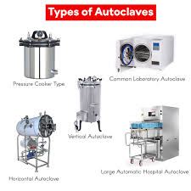
AUTOCLAVE
Instrument used to sterilize various equipments of the lab by wet sterilization method.
Derived from Greek name, Auto- Self; Clavis- Self locking device
Sterilization means destruction of all forms of life, present in inanimate objects by physical, chemical or gaseous methods.

Slide 75
Continued….
Pressurized device designed to heat aqueous solution above their boiling point at normal atmospheric pressure to achieve sterilization
Principle- Water heated in closed container- saturated steam is produced under pressure
According to Boyle’s Law, if volume of steam is kept constant, temperature is directly proportional to pressure.

Slide 76
Continued…
Moist heat coagulates all cell proteins of the microorganisms and hence kills off all the living entities in 15-20 minutes.
This method is efficient in destroying microorganisms, as it penetrates rapidly and gives the heat as it condenses on cooler objects.

Slide 77
APPLICATIONS
Hospitals and Medical officers use it to sterilize instruments before use.
Scientists use it to sterilize their equipment while carrying out experiments.
To sterilize waste material prior to discharge
To sterilize equipments and instruments used for different lab works.

Slide 78
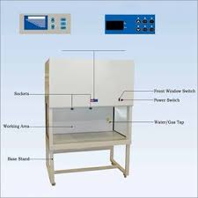
LAMINAR AIR FLOW
This instrument is an enclosed bench – made to prevent contamination of laboratory equipments, biological samples, or any particle sensitive material.
Air is passed from HEPA( High Efficiency Particulates Air) filter – removes all airborne contamination t maintain sterile conditions.

Slide 79
PARTS OF LAF
LAF Hood consists of filter pad, a fan, and a HEPA filter
The fan sucks the air through the filter pad where dust is trapped.
Pre-filtered air has to pass from HEPA filter, where contaminating fungi, bacteria, dust, etc are all removed.

Slide 80
Continued….
Sterile air passes into the working area – where all the flasking work can be done without the fear of contamination.
LAF chamber or cabinet is usually made up of stainless steel with no gaps or joints- prevents build up off bacteria in any place.
Air for the working environment is thoroughly cleaned by filtration process.

Slide 81
APPLICATION
To clean particle sensitive electronic devices.
In forensic labs, LAF is used while dealing with biological, chemical and toxicological samples.
Ideal for general lab work, in the areas of medical, pharmaceutical, electronic and industrial sectors.

Slide 82
INCUBATORS
Instrument used to grow and develop microorganisms or biological cells.
All incubators are based on the principle that when organisms are provided with the conditions of temperature, humidity, oxygen, and carbon dioxide levels, cells grow and divide to form more organisms.

Slide 83
Continued….
Thermostat maintains constant temperature- can be read from outside via thermometer
Temperature maintained by utilizing heating and no-heating cycles.
Heating cycle- thermostat heats the incubator
No- heating cycle- heating stopped; cooled by radiating heat to the surrounding

Slide 84
Similarly, other parameters are also maintained through different mechanisms that create an environment similar to that of natural environment.

Slide 85
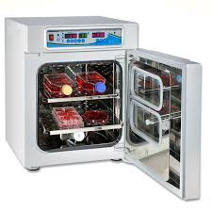
TYPES OF INCUBATORS
BENCHTOP INCUBATORS
CO2 INCUBATORS
COOLED INCUBATORS
SHAKER INCUBATORS
PORTABLE INCUBATORS

Slide 86
CO₂ INCUBATORS
Sealed, climate controlled boxes used in labs, to grow biological cell cultures.
They are required to maintain the same condition as inside the human body, i.e.
7.4 pH neutral
98.6°F (37 °C)
>90% relative humidity
Optimum conditions for cell growth

Slide 87
To culture cells under optimum conditions, media in which they are grown should have neutral pH.
The H2O in the cells can be turned into carbonic acid buffer by adding additional CO2.
The combination of H2O and CO2 results in bicarbonate(HCO3) and H2CO3, which keeps the pH neutral- and hence allowing the growth of biological cells

Slide 88
Continued….
Special kind of incubators provided with automatic control of CO2 and humidity.
Used for cultivation of bacteria or cells which require 5-10% of CO2 concentration.
For humidity control, water is kept underneath the cabinet of the incubator.

